Slide 1
Data Manipulation Language

Slide 2
DML stands for Data Manipulation Language.
It is a language used for selecting, inserting, deleting and updating data in a database.
It is used to retrieve and manipulate data in a relational database.
DDL commands are as follows,
1. SELECT
2. INSERT
3. UPDATE
4. DELETE
DML performs read-only queries of data.

Slide 3
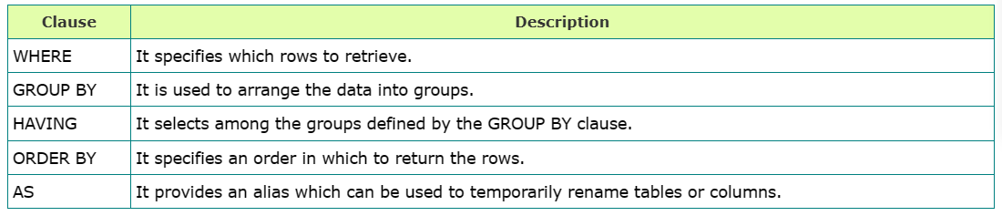
SELECT Command has many optional clauses are as stated below:
Syntax: SELECT * FROM <table_name>;
SELECT * FROM employee; OR SELECT * FROM employee where salary >=10,000;

Slide 4
2. INSERT COMMAND
INSERT command is used for inserting a data into a table.
Using this command, you can add one or more records to any single table in a database.
It is also used to add records to an existing code.
Syntax:
INSERT INTO <table_name> (`column_name1` <datatype>, `column_name2` <datatype>, . . . , `column_name_n` <database>) VALUES (`value1`, `value2`, . . . , `value n`);
Example:
INSERT INTO employee (`eid` int, `ename` varchar(20), `city` varchar(20)) VALUES (`1`, `ABC`, `PUNE`);

Slide 5
3. UPDATE COMMAND
UPDATE command is used to modify the records present in existing table.
This command updates existing data within a table.
It changes the data of one or more records in a table.
Syntax:
UPDATE <table_name>
SET <column_name = value>
WHERE condition;
Example : UPDATE Command
UPDATE employee
SET salary=20000
WHERE ename='ABC';

Slide 6
4. DELETE COMMAND
DELETE command is used to delete some or all records from the existing table.
It deletes all the records from a table.
Syntax:
DELETE FROM <table_name> WHERE <condition>;
Example : DELETE Command
DELETE FROM employee
WHERE emp_id = '001’;
If we does not write the WHERE condition, then all rows will get deleted.

Slide 7
5. MERGE
MERGE command is a combination of INSERT, UPDATE and DELETE. When two tables (source table and the target table) need to be merged then all the above mentioned three operations are performed all together using the MERGE command.
Merge in SQL merges two tables, a TARGET table, and a SOURCE table, to form a single TARGET table where entries are INSERTED, DELETED, or UPDATED based on their presence or absence on the source table.

Slide 8
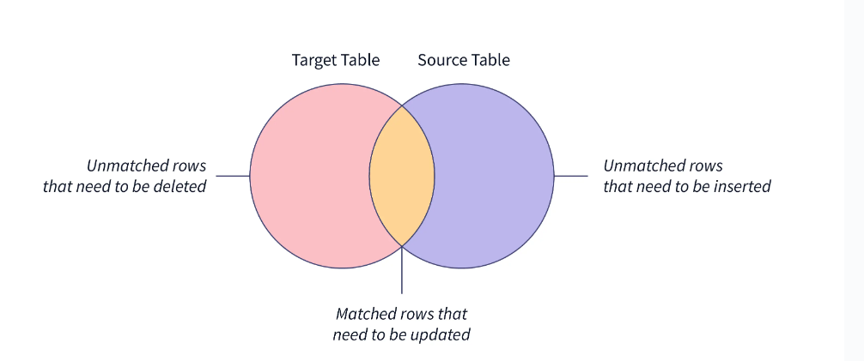

Slide 9
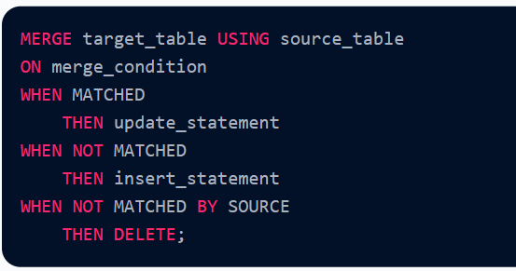
Syntax of MERGE STATEMENT
The SQL Server provides the MERGE statement, allowing you to simultaneously perform three actions INSERT, DELETE, and UPDATE. The below code shows the syntax of the MERGE statement:

Slide 10
Advantages of Data Manipulation Language
Though DML is the lifeline when talking about performing operations in a structured database. Some of the advantages of DML are given below:
DML commands give us the flexibility to retrieve the data according to the requirements by applying the conditions using the WHERE clause.
Data stored in the database can easily be modified anytime and that too very easily using the DML commands.
DML provides the facility of the efficient and fast interaction of the human (end-user using the system) with the system or the backend data stored in the database.
We can apply the various restrictions at the schema level and yet provide some privilege to the end-user to manipulate and retrieve the data under a controlled environment.
Moreover, the end-user cannot make any modification at the schema level in the database using DML which again is an advantage when talking about privacy issues.

